Slide 1
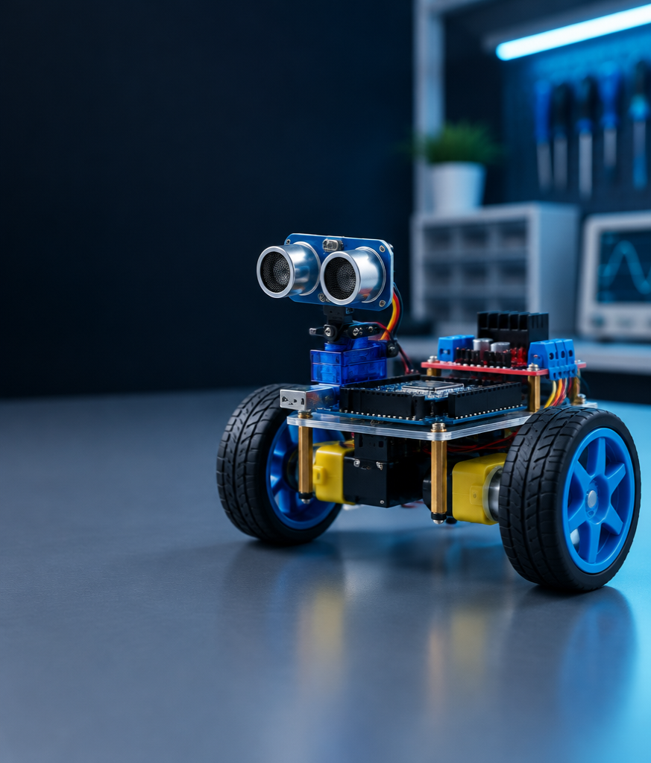
Implementation of an
Obstacle-Avoiding Robot
Arduino • Ultrasonic Sensor • L298N Motor Driver
CSE2102 | Microprocessor and Microcontrollers Lab
Department of Computer Science and Engineering
Begum Rokeya University, Rangpur
2nd Year | 1st Semester | Session 2023–2024
12 October 2026
CSE2102 | Microprocessor and Microcontrollers Lab
01

Slide 2
Submitted By / Submitted To
SUBMITTED BY
SUBMITTED TO
NAME ID REGISTRATION NO
Mithun Chandra Sarker 12305011 000018528
Md Abdullah Al Khalid Alif 12305016 000018533
Md Rakibul Islam 12305039 000018556
Marija Sultana
Assistant Professor
Department of Computer Science and Engineering
Begum Rokeya University, Rangpur
Year: 2nd Year • Semester: 1st Semester • Session: 2023–2024
Department of Computer Science and Engineering
Begum Rokeya University, Rangpur
CSE2102 | Microprocessor and Microcontrollers Lab
02

Slide 3
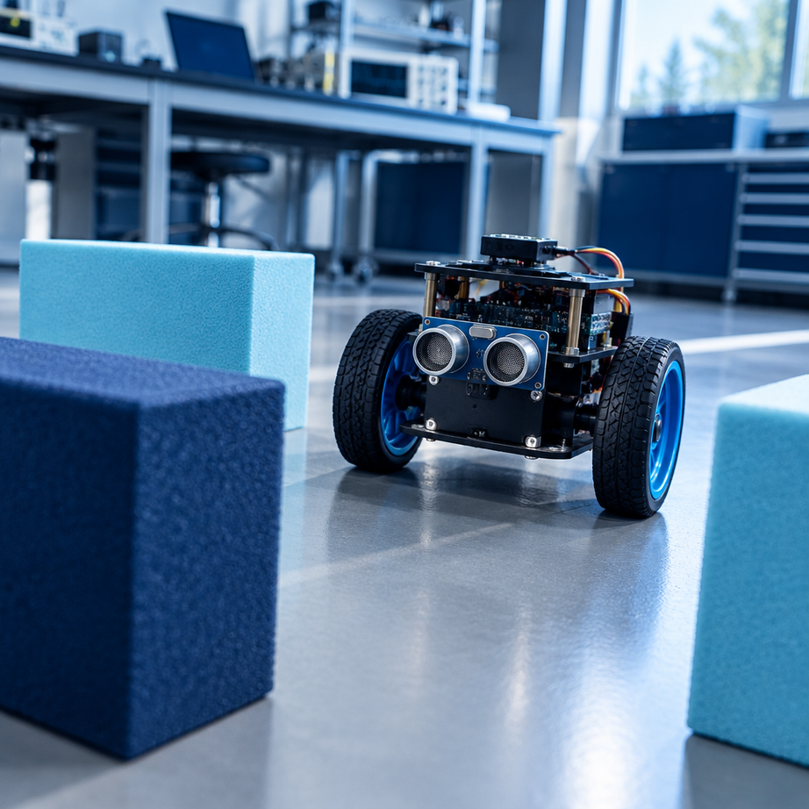
Introduction & Motivation
Why autonomy matters in a compact educational platform
From manual control
to independent motion.
Remote-controlled robots depend on an operator and communication range. This project develops a low-cost 2WD robot that senses its surroundings, chooses a safe path, and moves without supervision.
LEARNING FOCUS
Microcontroller interfacing • timing • control logic
CSE2102 | Microprocessor and Microcontrollers Lab
03

Slide 4
Problem Statement
A robot must sense, decide, and act—without supervision
01
SENSE
A single forward sensor has limited spatial awareness.
02
DECIDE
The environment must be scanned to compare multiple paths.
03
ACT SAFELY
Invalid echoes require a fail-safe response, not blind motion.
CSE2102 | Microprocessor and Microcontrollers Lab
04

Slide 5
Objectives
Five concrete engineering outcomes
LOW-COST PLATFORM
DISTANCE SENSING
LEFT / RIGHT SCAN
Autonomous 2WD chassis
HC-SR04 obstacle detection
SG90 servo at 150° / 30°
PWM MOTOR DRIVE
TURN MANEUVERS
L298N dual H-bridge
90° turns and 180° recovery
CSE2102 | Microprocessor and Microcontrollers Lab
05

Slide 6
Scope of the Work
Deliberately focused on robust indoor autonomy
INCLUDED
OUT OF SCOPE
Hardware assembly
Wiring and firmware
Control algorithm
Fail-safe logic
Testing and documentation
SLAM
Computer vision
Advanced path planning
Wireless control
FOCUS / Low-cost autonomous obstacle avoidance in an indoor environment—with maximum educational value.
CSE2102 | Microprocessor and Microcontrollers Lab
06

Slide 7
System Architecture
Sensing → processing → power stage → actuation
HC-SR04 + SG90
SENSING
ARDUINO UNO
PROCESSING CORE
L298N
DUAL H-BRIDGE
2 × TT MOTORS
ACTUATION
18650 BATTERY + 5V REGULATION
CSE2102 | Microprocessor and Microcontrollers Lab
07

Slide 8
Hardware Components
Bill of materials and functional role
COMPONENT QUANTITY PURPOSE
Arduino Uno 1 Main controller
L298N Motor Driver 1 Motor control
TT Gear Motor 2 Robot locomotion
HC-SR04 Ultrasonic Sensor 1 Obstacle detection
SG90 Servo Motor 1 Sensor scanning
2WD Chassis 1 Robot frame
18650 Battery 1 Power source
Jumper Wires & Breadboard Various Connections
7805 Voltage Regulator 1 Stable 5V supply
CSE2102 | Microprocessor and Microcontrollers Lab
08

Slide 9
Pin Mapping & Wiring
Deterministic I/O allocation for sensing and motor control
SIGNAL ARDUINO PIN NOTES
ENA 3 Motor A enable (PWM)
WIRING NOTES
Remove ENA/ENB jumpers on L298N.
A common ground is mandatory across Arduino, driver, sensor, servo, and battery.
IN1 7 Motor A input 1
IN2 6 Motor A input 2
IN3 5 Motor B input 1
IN4 4 Motor B input 2
ENB 11 Motor B enable (PWM)
TRIG 9 Ultrasonic trigger
ECHO 8 Ultrasonic echo
SERVO 10 Servo control
CSE2102 | Microprocessor and Microcontrollers Lab
09

Slide 10
Overall Working Principle
A continuous sense–decide–act loop
01 SENSE
02 DECIDE
03 ACT
Trigger pulse → echo duration
Distance = (duration × 0.0343) / 2
Forward • left • right • turnaround
Valid: 2–200 cm | Timeout: 12,000 µs
Obstacle when distance ≤ 30 cm
PWM commands drive both motors
CSE2102 | Microprocessor and Microcontrollers Lab
10

Slide 11
Control Logic / State Machine
Cruise at PWM 130; scan only when the forward path is blocked
SCAN LEFT
150°
CRUISE
PWM 130
OBSTACLE ≤ 30 cm?
STOP & SETTLE
150 ms
COMPARE
LEFT vs RIGHT
SCAN RIGHT
30°
TURN LEFT
PWM 230
TURN AROUND
800 ms
TURN RIGHT
PWM 230
CSE2102 | Microprocessor and Microcontrollers Lab
11

Slide 12
Decision Logic & Tuning Parameters
All behavior is governed by explicit, testable constants
PARAMETER VALUE DESCRIPTION
NORMAL_SPEED 130 Cruising PWM
DECISION RULE
| Left − Right | ≤ 5 cm
→ execute 180° turnaround
TURN_SPEED 230 Turn PWM
UTURN_SPEED 230 180° turn PWM
OBSTACLE_LIMIT 30 cm Obstacle threshold
EQUAL_LIMIT 5 cm Equal-side tolerance
SERVO_CENTER 90° Center angle
SERVO_LEFT / RIGHT 150° / 30° Scan angles
TURN_90_TIME 400 ms 90° duration
TURN_180_TIME 800 ms 180° duration
CSE2102 | Microprocessor and Microcontrollers Lab
12

Slide 13
Implementation / Software
Arduino IDE • Servo library • two-source-file structure
CONTROL CYCLE
obstacle_avoiding_robot.ino
obstacle.cpp
setup() initialize pins, servo, serial
loop() main control cycle
getDistance() trigger, time, validate
scanSides() acquire left / right distances
forward() apply cruise PWM
stopCar() zero motor outputs
turnLeft() / turnRight() / turnAround()
Firmware separates sensing, decision-making, and actuation into small testable functions.
CSE2102 | Microprocessor and Microcontrollers Lab
13

Slide 14
Results & Test Cases
10 / 10
All 10 test cases passed without false observations
TEST CASE DESCRIPTION EXPECTED BEHAVIOR RESULT
Clear path No obstacles Forward motion PASSED
Obstacle left ≤ 30 cm left Turn right PASSED
Obstacle right ≤ 30 cm right Turn left PASSED
Obstacle front Both sides blocked 180° turnaround PASSED
Boundary test Exactly 30 cm Correct turn PASSED
Invalid < 2 cm Sensor error Fail-safe stop PASSED
Echo timeout No echo Fail-safe stop PASSED
Invalid side Servo scan error Fail-safe action PASSED
CSE2102 | Microprocessor and Microcontrollers Lab
14

Slide 15
System Output / Serial Monitor
9600 baud • live evidence for debugging and validation
> Front: 25 cm
> Front: INVALID
> Left: 40 cm
> Right: 35 cm
> Decision: Turn Left
VALID DISTANCE
Confirms echo timing and conversion.
INVALID READING
Triggers the fail-safe path.
SIDE SCAN + DECISION
Shows the evidence behind each maneuver.
CSE2102 | Microprocessor and Microcontrollers Lab
15

Slide 16
A low-cost robot that can
sense, decide, and recover.
ACHIEVED
Validated 2WD autonomy with ultrasonic sensing, servo scanning, PWM motor control, and fail-safe behavior.
NEXT
Multi-sensor array • encoders / IMU • PID speed control • wireless monitoring • grid-based planning
Thank you. Questions?
CSE2102 | Microprocessor and Microcontrollers Lab
16

